Slide 1


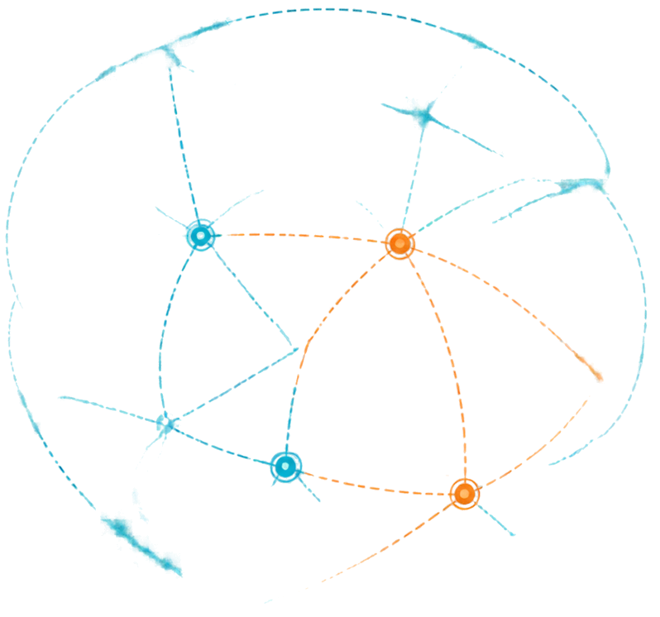








Intelligent Routing for Dynamic Satellite Networks
A simulator for routing data between satellites and ground stations under motion, link failures, and changing network conditions
Laphing Budhha
-Aayush Kumar Choubey
-Abhinav Sunam
-Nikita Singh
-Saorabh Yadav

Slide 2



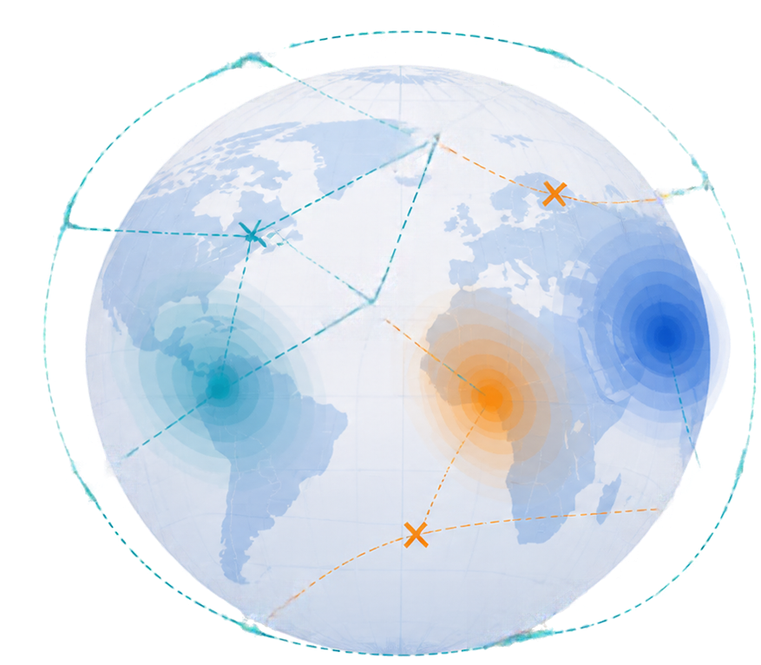









Problem Statement and Background
Challenges in LEO Satellite Networks
LEO constellations such as Starlink and OneWeb enable global internet, navigation, IoT, and disaster communication
Satellites move at ~7 km/s, creating constantly changing topology
Links fail due to weather, interference, hardware faults, and eclipses
Traffic load and latency vary by region and time
Our goal:
Build a simulator that intelligently routes data despite motion, failures, and congestion.

Slide 3
















Proposed Dynamic-Graph Simulator
Continuously simulates satellite motion and link conditions
Adapts routes in real time and benchmarks against a static baseline
Handles failures and congestion to reflect real-world dynamics
Delivers live network insights through an interactive dashboard
Orbit Data
Network Graph
Routing Engine
Data Delivery
Metrics
Simulate orbits and compute real-time satellite positions
Model inter-satellite links and connections to ground stations
Run adaptive routing algorithm and update paths continuously
Route data across the network under dynamic conditions
Track performance and compare adaptive vs. static routing

Slide 4






















System Architecture
Orbit Simulation Engine
Computes satellite
positions over time
A modular pipeline that simulates, routes, and visualizes dynamic satellite networks.
Determines feasible links based on distance and
line-of-sight
topology Builder
Simulates latency, bandwidth, packet loss, and random failures
Network Condition Model
Routing Engine
Calculates paths and
reroutes dynamically
Visualization and Metrics Dashboard
Displays live network
and performance data

Slide 5






























Routing Algorithm and Approach
Chosen Path
Alternative Path
Other Links
Adaptive routing with cost-aware weighted edges
Routing Method
Reroutes
on Failure
Considers
Congestion
Handles
Movement
Performance
Static Shortest Path
No
No
No
Low
Dijkstra on
Live Graph
Yes
Limited
Partial
Moderate
Adaptive Cost-Aware
Routing (ours)
Yes
Yes
Full
Best
Cost
Formula
Cost = a×Latency + b×Congestion + c×Failure Risk
Nodes represent satellites and ground stations
Edges represent communication links

Slide 6





















Handling Dynamic Events
Satellite Movement
Link Failures
Network Congestion
Topology refreshed each time step
Detect via heartbeat or timeout
Load-aware edge weights updated dynamically
Handover between satellites as they move
Instant removal of failed links from graph
Traffic splitting to avoid overloaded links
Predicts link availability windows in advance
Reroute through backup paths immediately
Adaptive rerouting to balance load
Link
fails
Failure detected
Graph
updated
New route computed
Data
delivered

Slide 7


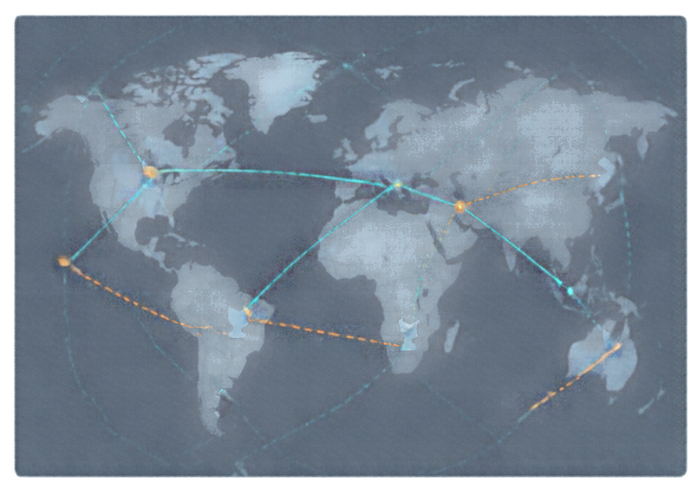






















Simulator Features and Dashboard
Explore the network. Control the simulation. Measure performance in real time.
Network View
Controls
Performance
Logs
Simulation Running
Powerful features for dynamic networks
Live Metrics
End-to-end Latency
28 ms
Real-time visualization of satellite network and routing
Packet Delivery Ratio
98.7%
Adjustable number of satellites and ground stations
Reroutes Performed
1.2
Manual and random failure injection controls
Link Uptime
99.2%
Algorithm switching capability (static vs adaptive)
Network Throughput
1.26 Gbps
Live performance
metrics display
Active Route
Alternate Route
Satellite
Ground Station
All Systems Nominal

Slide 8









Results and Performance Comparison
Average latency (ms)
Packet delivery ratio (%)
Failure recovery time (s)
Key takeaways
250
100
94
100
85
210
Adaptive routing enables faster recovery from
link failures
200
80
72
80
150
60
60
95
100
40
40
25
50
20
20
Significantly higher
packet delivery success
under dynamic conditions
0
0
0
Static routing
Adaptive routing
Static routing
Adaptive routing
Static routing
Adaptive routing
Metric
Static routing
Adaptive routing
Improvement
Average latency (ms)
210
95
54% lower
Better load balancing
reduces congestion
and latency spikes
Packet delivery ratio (%)
72
94
22% higher
Failure recovery time (s)
85
25
71% faster

Slide 9














Applications, Tech Stack and Future Scope
Applications
Tech Stack
Future Scope
Disaster-area communication networks
Python programming
Machine learning for route prediction
Remote and rural internet connectivity
NX
NetworkX for graph processing
Reinforcement learning for adaptive routing
Maritime and aviation network coverage
NumPy for numerical computations
Integration with real orbit data (TLE files)
Global IoT data relay
Matplotlib/Plotly for visualization
Laser inter-satellite links simulation
Defense and secure communication
Optionally web-based
dashboard frameworks
Multi-priority traffic handling
Thank You!
We appreciate your time and look forward to building the future together.

